Slide 1
SIH- 2020
ORGANISATION : CDK GLOBAL
PROBLEM STATEMENT : Portal for Farmers to sell the produce at a better rate
PROBLEM CODE: RA27
TEAM NAME : HACKING BAD
TEAM LEADER NAME : ARSH GOYAL
COLLEGE CODE : U-0374
Problem Statement Description :
System that provides farmers an interface to sell their produce , and connect with the buyers all over India
Simple interface that works on mobile, SMS to upload produce details and respond via phone and SMS (taking care of digital divide)
Interface for anyone to buy the produce/vegetable – initially visit the place and buy or have courier service integrated to deliver the vegetables .
Technology that can be used as a platform for connecting car buyer to Seller
Farmers can get a better price for their produce, no additional cost spent in marketing and delivery of goods , however they can choose to charge more by delivering the items themselves

Slide 2






Solution:
Daily Marketplace:
Notifications/SMS
Notifications and SMS of
latest Bids on the crops.
Evaluate Bids
Accept or Reject a Bid
on crop .
Message Buyer
using chat service to
Negotiate price etc.
Acknowledgement
After order is Confirmed
from buyer pickup, payment etc. details are sent to farmer .
SMS service
Icon and Text
based Simple Multilingual Platform.
Publish their crops
with complete details like :
Select Crop and Category
from a large list of all general
crops and categories .
Quantity and Expected Price
Quality Certifications :
Certified Organic , Verified by etc.
Modify Crops
based upon local sales.
Daily Market for Perishable goods:
1. Established in early morning hours (5-8 a.m.) by farmers.
2. After that bidding portal will open and buyers can bid for the crop unanimously.
3. After bidding time is up (1 p.m.) farmer can select the buyer among top bidders.
4. Orders will be acknowledged from both side and will to be delivered by next day.
Publish crops from their verified mobile number.
New bid SMS with details about bid and its Unique Reference no.
Select bid via SMS by bid’s reference no.
Acknowledgement SMS with complete details is send to farmer.
Farmers
New Bid?
A Web and App easy to use portal
Bid
on crops with their offered price.
Suggestions
Based upon previous purchases, business type etc.
Question/Answer to farmers.
Crop Recommendation Section:
Search, Filter and Sort the crops on basis of:
Buyer
Cart and Favorites
1. Farmer Decision Support Model based upon user’s Location based Weather and previous Sales dataset.
2. It would suggest farmer which crop’s he should grow during which part of year based upon his location,
predicted weather and
Location based sales of the crops on the portal.
Location
Quality
Delivery
on desired address or pickup from farm.
Confirmation
of order after bid is accepted .
A Web and App portal
Price
Payment
through integrated payment portal
Farmer’s Rating
Stubble/Husk Section:
Technology Stack:
1. Special Section for Stubble(Farming Waste) selling to Industries/Bio-organic/ Electric Power plants instead to burning in fields which will reduce pollution.
2. Additional Income for farmers and easy fuels for the industries.
1. HTML5,CSS3
2. Bootstrap
3. PostgreSQL
4. Django
5. Python
6. NumPy
7. Pandas
8. Machine Learning

Slide 3
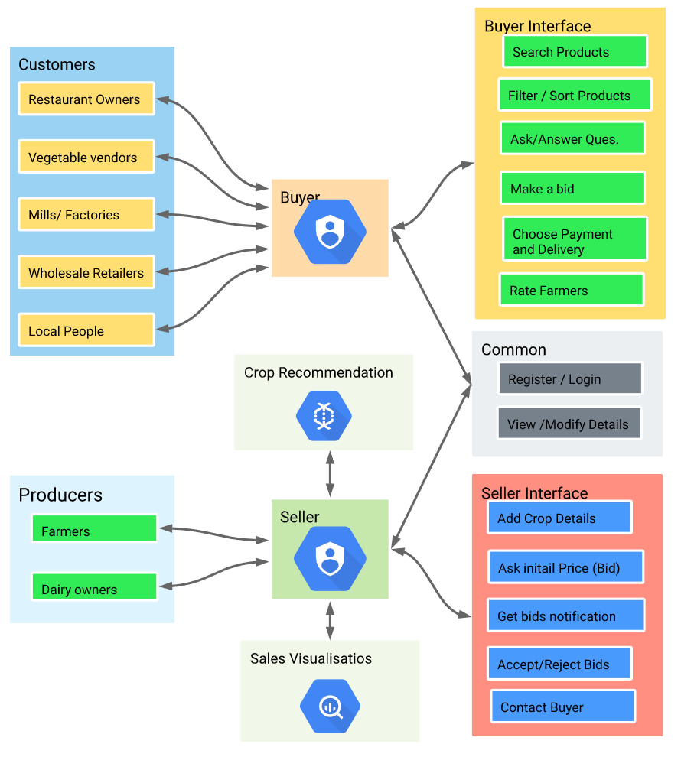
Use Cases :
Salient Features :
Visualizations:
Simple ,easy to understand Visuals (graphs etc.) and their textual interpretations on region based: crop sales, prices offered, frequency of sales data to help farmers better understand sales dynamics of the region and decide selling price and crop to be grown.
MSP
Minimum Support Price restriction and no crop will be sold for lower than it’s MSP .
Help section
Integrated Help section on each page containing Tutorial on How to use and Walkthrough of that feature so that farmers can easily use the portal .
Simple SMS service will enable famers with no regular internet connection (Digital Divide) to use the portal and sell their produce .
Buyer Homepage will contain personalized suggestions based on kind of his business requirements and previous activity on the portal to improve engagement’s.
Daily Market to replicate the traditional system of Mandis and supplying to local vegetable vendors, restaurants etc.
Direct Chat Service between farmer’s and buyers to clear any queries , doubts and transparent working of the platform .
Once the bid is accepted buyer has to confirm the order within a fixed Time limit, after which farmer can move to and select another bid.
Dependencies:
SMS Provider
Location Based Weather Dataset
MSP (Minimum Support Price ) Data.
Secure Payment Gateway.

